Slide 1

“People search, watch, and keep in touch”
Sue Moon
in collaboration with
Yong-Yeol Ahn, Meeyoung Cha, Hyunwoo Chun, Seungyeop Han, Haewoon Kwak,
Jon Crowcroft, Hawoong Jeong, Pablo Rodriguez

Slide 2
Alexa.com
1 | Yahoo.com
2 | MSN.com
3 | Google.com
4 | YouTube.com
5 | Live.com
6 | MySpace.com
7 | Baidu.com
8 | Orkut.com
9 | Wikipedia.org
10 | qq.com
2007.6.26.
Notes:
baidu.com – google like
qq.com – naver like

Slide 3
``People search, watch, and keep in touch”
-- Yong-Yeol Ahn

Slide 4
What did we do before Internet?

Slide 5
Remember POTS?
POTS = Plain Old Telephone Service

Slide 6
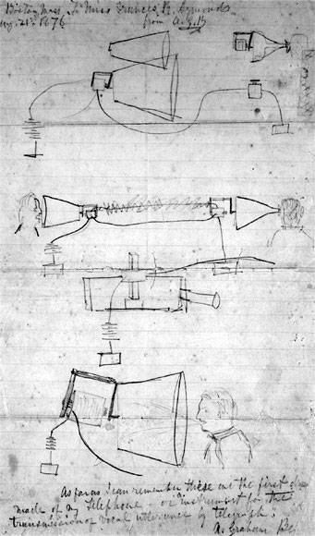
Graham Bell’s Illustration

Slide 7
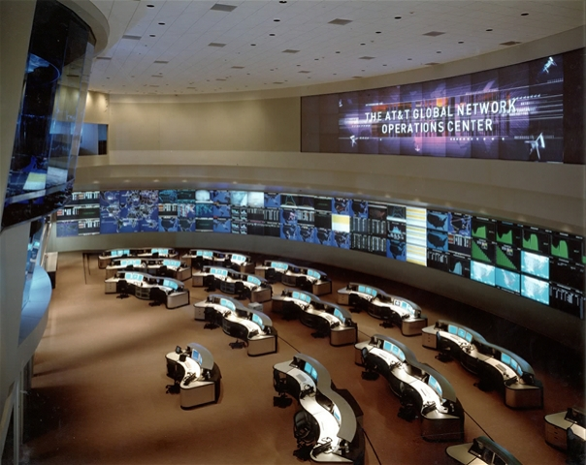
Today’s Telephone Network

Slide 8
People only talked

Slide 9
Predictable Behaviors
which translates to

Slide 10
Applicability of same user behavior model over time
which translates to

Slide 11
Easy planning and Management
which translates to

Slide 12
NOW ...

Slide 13
``People search, watch, and keep in touch”
-- Yong-Yeol Ahn

Slide 14
Why should computer scientists care?

Slide 15
Why do I care?

Slide 16
``People search”
They submit queries to search engines
Queries reflect “collective mind”
10 most searched keywords
Blog tags also reflect “collective mind”
Infer relations between words from blog tags? [4]

Slide 17
``People watch”
News with still images
Not “watch” but “browse”
VoD (Video On Demand)
UCC (User Created Contents) [2]
IPTV [3]

Slide 18
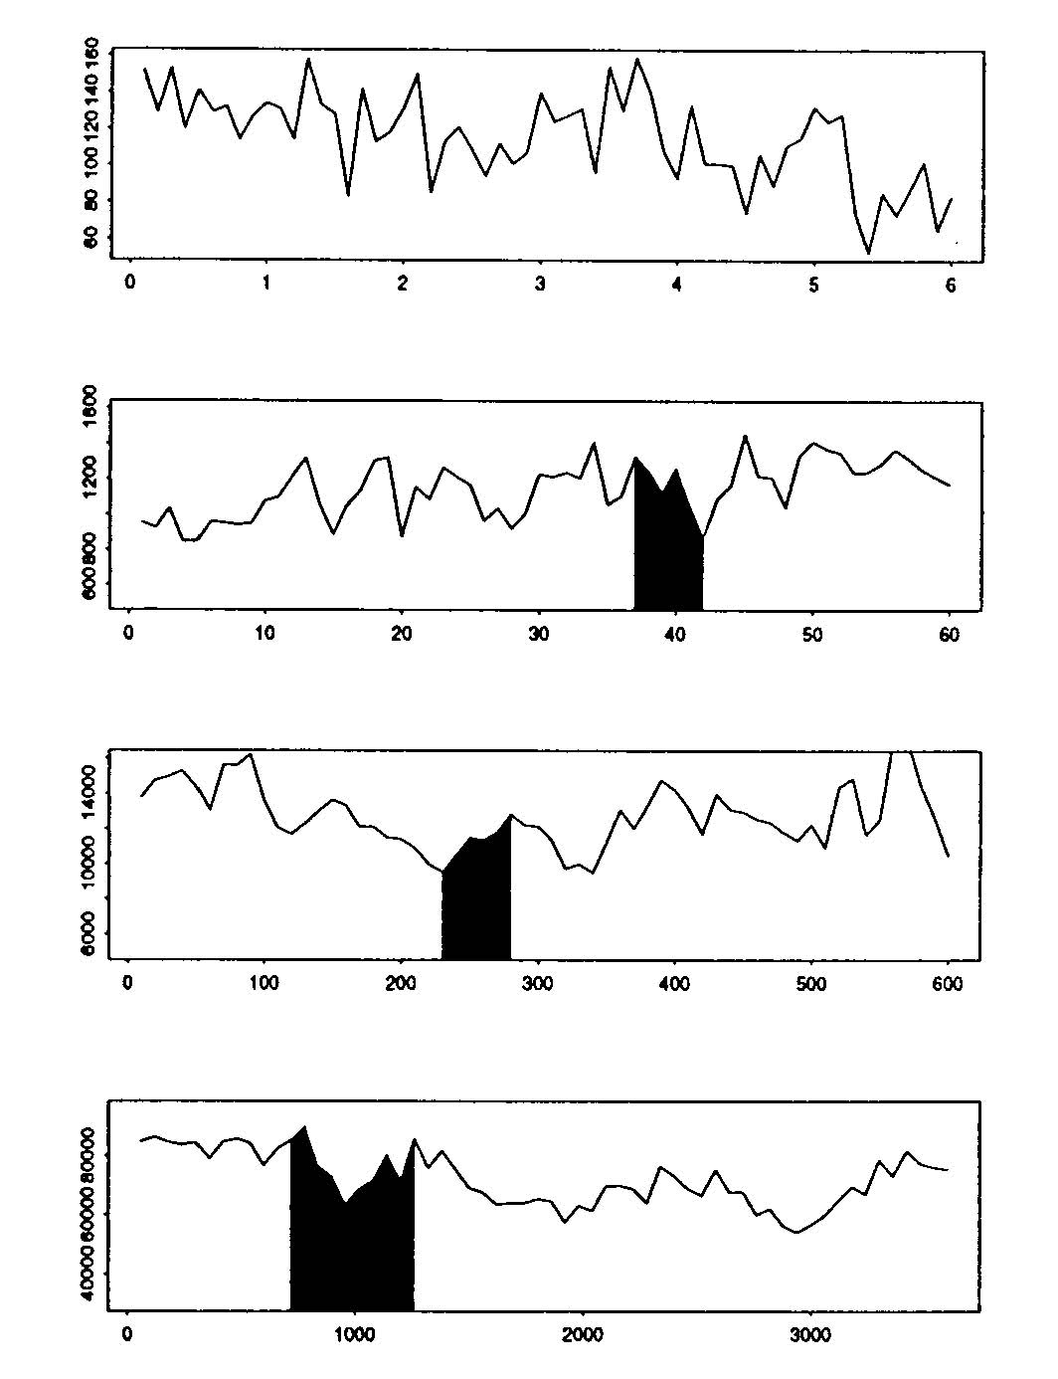
Implications (I)
[5]

Slide 19
Implications (II)
“Network traffic to grow up to sixfold annually”
Cisco CTO
Remember “Tech Bubble Burst”?

Slide 20
``People stay in touch”
Emails and messages
Implicit, not explorable
Social networking services
Explicit, connection visible
Opportunities for business

Slide 21
From a computer scientist’s point of view

Slide 22
``People search”
They submit queries to search engines
Queries reflect “collective mind”
10 most searched keywords
Blog tags also reflect “collective mind”
Infer relations between words from blog tags? [4]

Slide 23
``People watch”
News with still images
Not “watch” but “browse”
VoD (Video On Demand)
UCC (User Created Contents) [2]
IPTV [3]

Slide 24
``People stay in touch”
Emails and messages
Implicit, not explorable
Social networking services
Explicit, connection visible
Opportunities for business

Slide 25
I Tube, you tube, everybody tubes

Slide 26
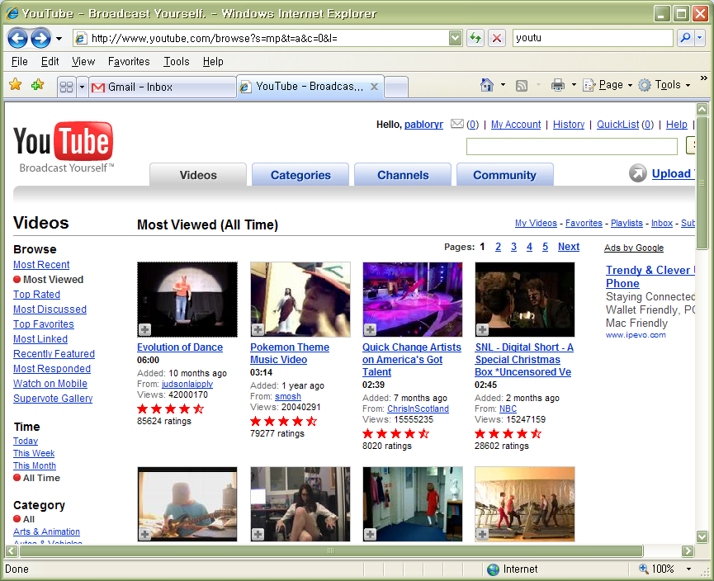
YouTube System
Largest VoD for user
generated contents
Founded in Feb ’05
Some daily statistics
- 100M videos served
- 65K videos uploaded
- 60% of online videos
served via YouTube
40-50 Gbps bandwidth estimated

Slide 27
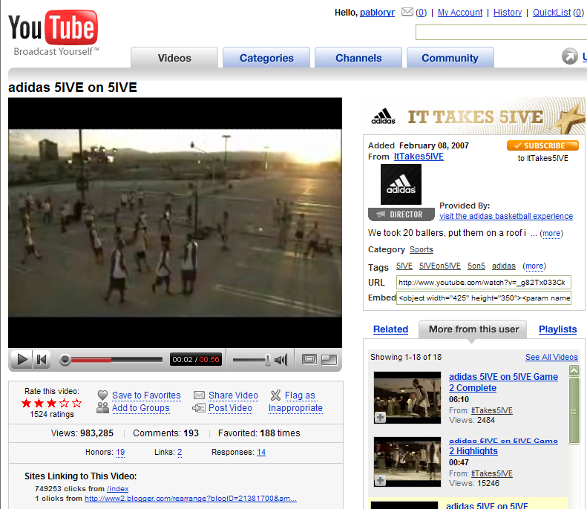
Video Example
Owner
Upload time
Runtime
Views
Ratings
Stars
Comments
Honors
Linking pages

Slide 28
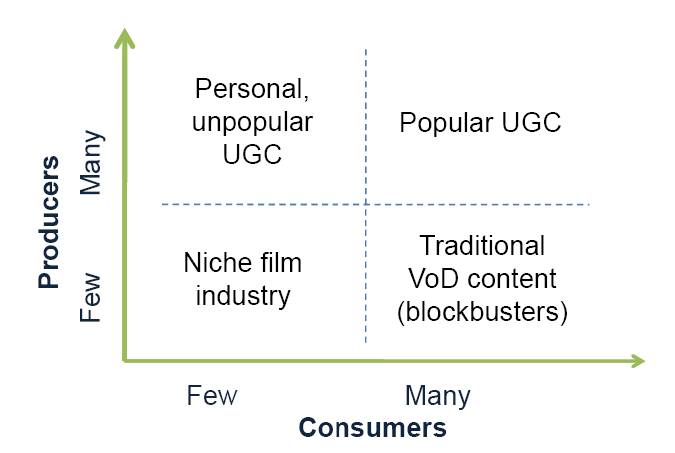
Content producers, consumers

Slide 29
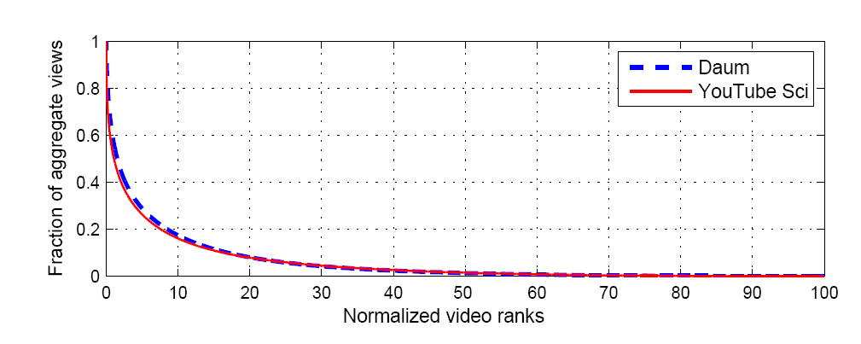
Pareto Distribution
(max view=8.5M)
(max view=2.5M)
  Massive files (90%) account for 20% views
  Small set of files (10%) with 80% of views
(< 1K views)
Heavy-tail

Slide 30
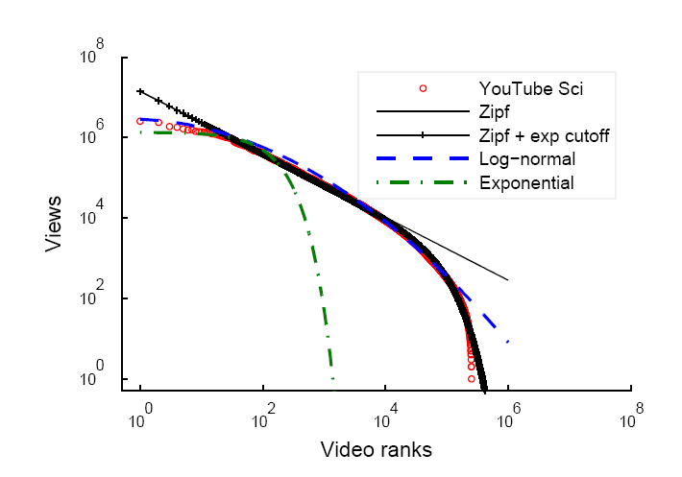
Zipf (Power) with exp cutoff

Slide 31
Popularity Evolution

Slide 32
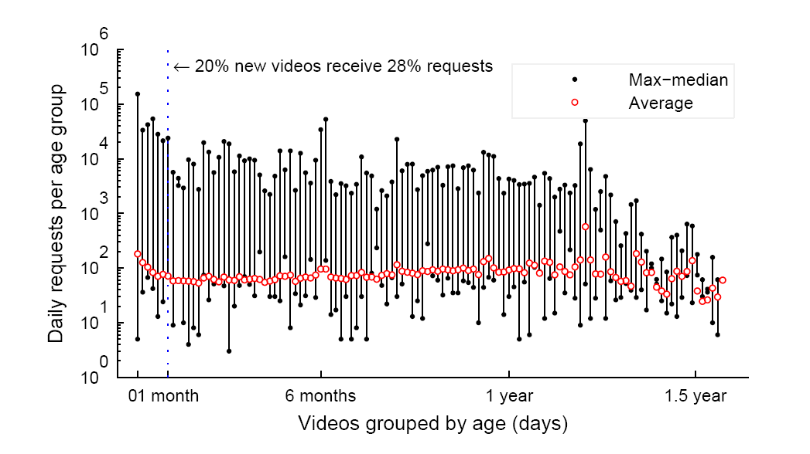
Age of daily viewed videos

Slide 33
Watching Television Over
Nationwide IP Multicast

Slide 34
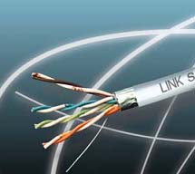
Quality-assured IPTV architecture
TV
head end
customer
premise
TV
1Gb/s
home
gateway
STB
Internet
ISP
IP backbone
phone
5Mb/s
DSLAM
PC
IPTV (5 Mb/s)
1-2 channels
Internet (1 Mb/s)
Last mile
(6 Mb/s)
VoIP

Slide 35
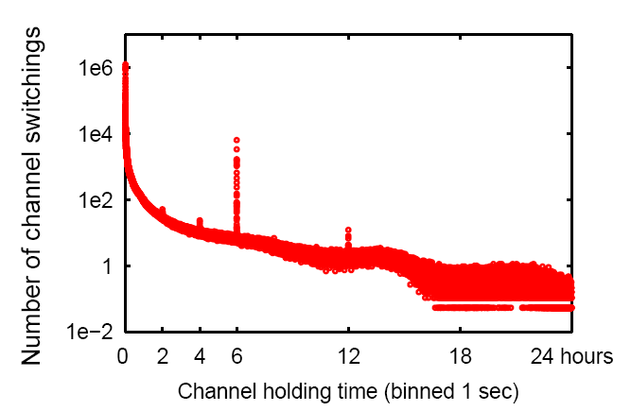
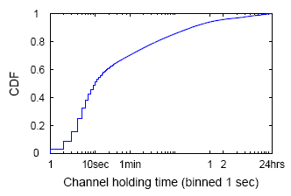
Channel holding time
Spikes in histogram: natural long-term off hours?
Tipping point in CDF
Browse View Away
,

Slide 36
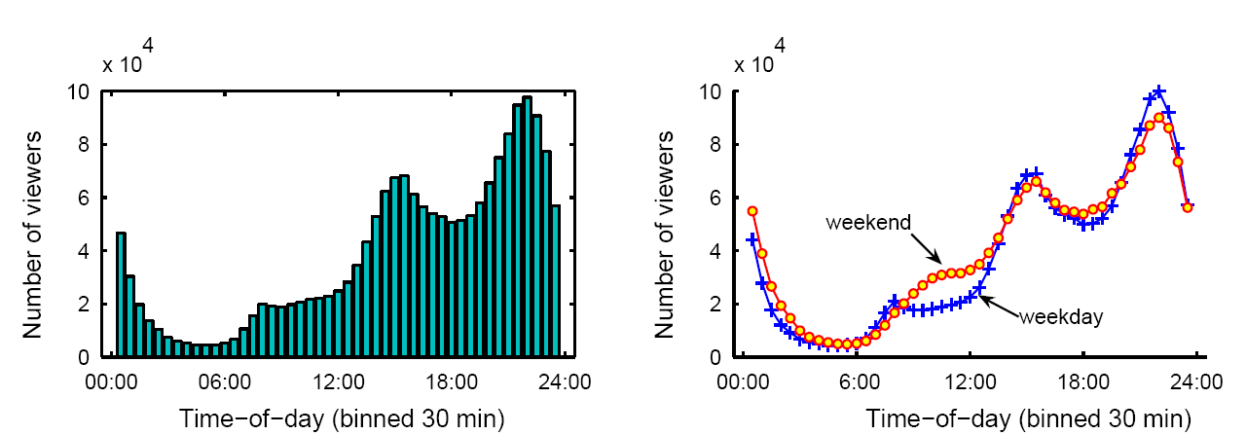
Number of viewers over time
Time-of-day effect
18% increase in viewing over weekends

Slide 37
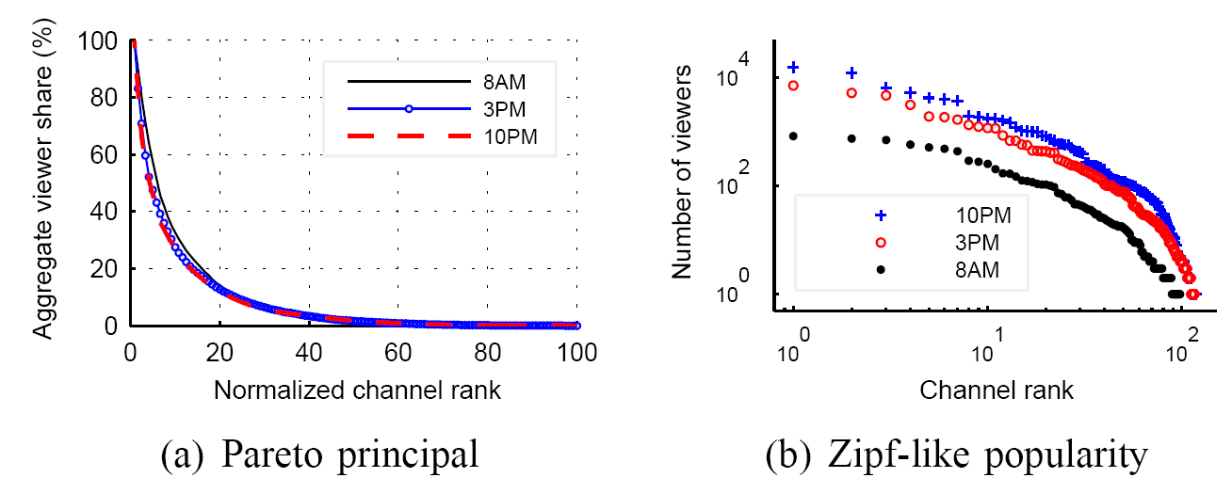
Channel popularity
Top 10% channels account for 80% viewer share
Zipf-like popularity – also shown in PPLive

Slide 38
Static vs Dynamic Multicast Trees
Source
IP router
cost = 2
cost = 1
DSLAM
STB
Static
Dynamic

Slide 39






Alternate designs for live TV
Server-based IP multicast
co-exist
within
ISP
Server-based
IP unicast
Server-less P2P unicast
How do these technologies compare?

Slide 40
Example routing
TV head end
Regional
server
IP router
cost = 4
cost = 3
cost = 7
DSLAM
STB
CDN
Locality-aware P2P
Topology-oblivious P2P

Slide 41
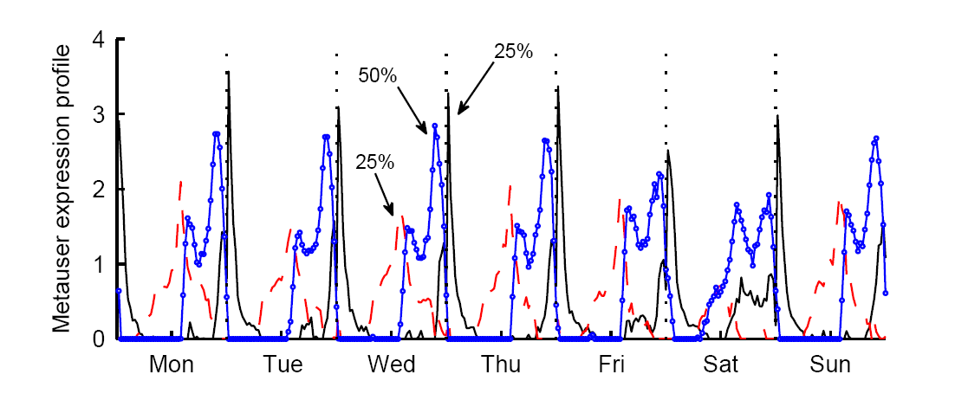
User Clustering
Peep into life-styles of users using NMF
Early-birds
25%
Always-On
50%
Night Owls
25%
Notes:
Mention we find three-clusters as that was the best heuristic.
Besides three, seven was also a good number!

Slide 42
Channel Correlation
Nationals
Music1
Music2
Movies
Documentals
La Sexta
Tele 5
Sol musica
6
5
Trace TV
Extreme TV
Documania
111
116
42
233
4
1
40 Latino
110
Cuatro
3
2
Tve 1
112
118
43
234
Antena 3
Tve 2
40 TV
MTV Base
MGM
Docu TV

Slide 43
Analsys of huge online social networking services

Slide 44
CyWorld

Slide 45
MySPACE

Slide 46
Orkut

Slide 47
Online Social Networking Services
Portal for people to …
  Stay in touch with friends
  Share photos and personal news
  Find others of common interests
  Establish a forum for discussion

Slide 48
CyWorld
Largest SNS in South Korea
  Started in September 2001
  10 million users in 2004
  16 million users out of 48 million population
Front runner of many features
  Friend (il-chon) relationship
  Guestbook
  Testimonial (il-chon-pyung)
  Photos - scraps
  Avatar in cyber home

Slide 49
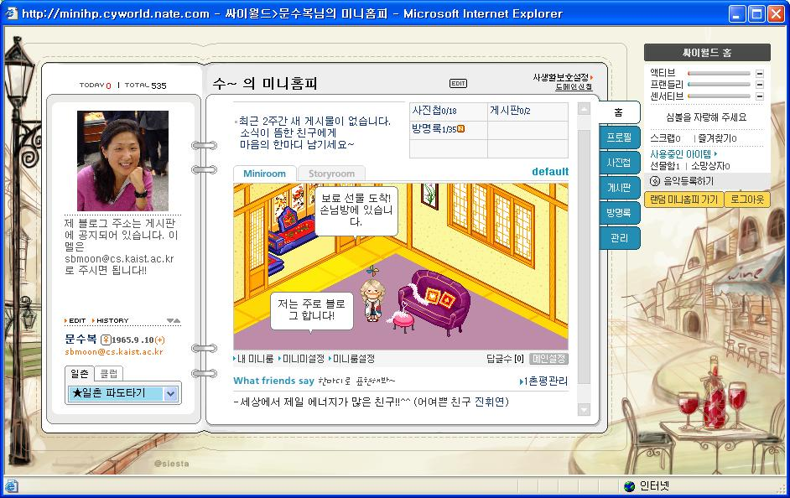
My CyWorld “Mini-Homepage”

Slide 50
CyWorld Data Sets
Complete snapshot (Nov 2005)
  191 million friend relationships between 12 million users
  Two additional snapshots (Apr/Sep 2005)

Slide 51
MySpace Data Set
Largest in the world
  Began in Jul 2003
  Has 130 million by Nov 2006
Snowball sampled
  During Sep/Oct 2006
  Random seed to 100,000 users
  About 23% of users had friend list hidden

Slide 52
Orkut Data Set
Google SNS
  Began in Sep 2002
  Became official Google service in Jan 2004
  Began as invitation-only; open now
  Has 33 million users
Snowball sampled
  During Jun to Sep 2006
  100,000 users

Slide 53
Metrics of Interest
Degree distribution
  “Power-law”
    Small number of nodes have large numbers of links
Clustering coefficient C(k)
  # of existing links / # of all possible links between a link’s adjacent neighbors
    Close to 1, close to a mesh
Degree correlation k_{nn}
  Degree k ~ mean degree of adjacent neighbors of nodes with degree k
  Assortativity: characteristic of k_{nn} distribution

Slide 54
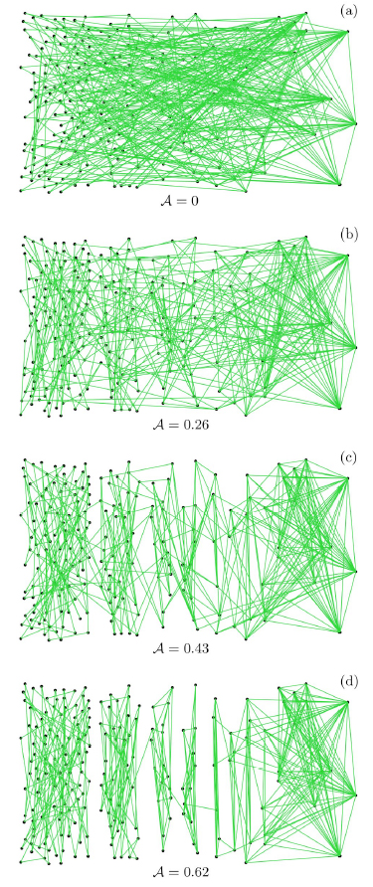
Assortative Mixing
+
“Social”
“non-
social”
-
M. E. J. Newman, Phys. Rev. Lett. 89, 208701 (2002)
assortative
54
degree

Slide 55
Questions We Raise
What are the main characteristics of online SNSs?
How representative is a sample network?
How does a social network evolve?

Slide 56
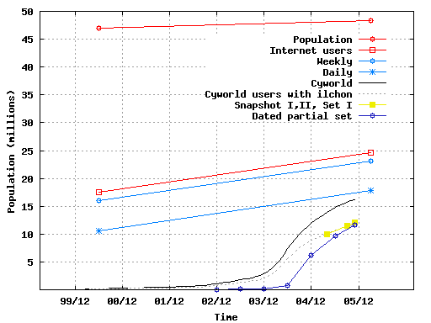
Historical Analysis

Slide 57
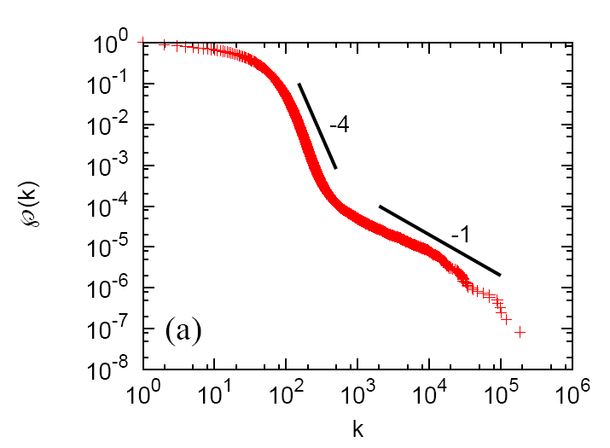
Degree Distribution
Two scaling regions
Figure 1-(a): degree distribution, CCDF

Slide 58
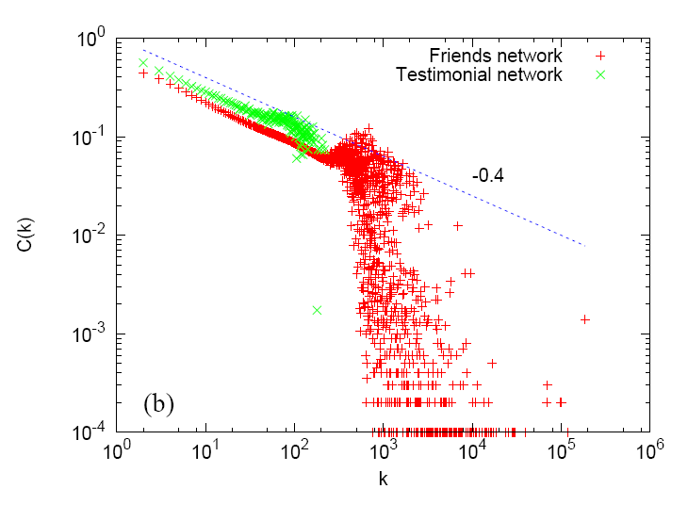
Clustering Coefficient Distribution

Slide 59
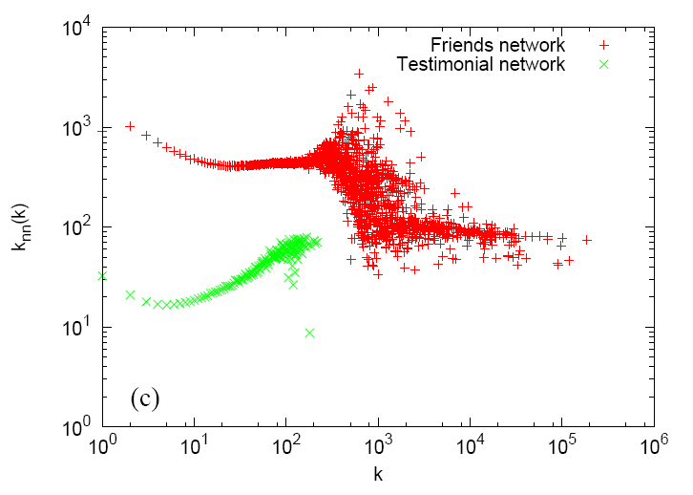
Degree Correlation
Not assortative

Slide 60
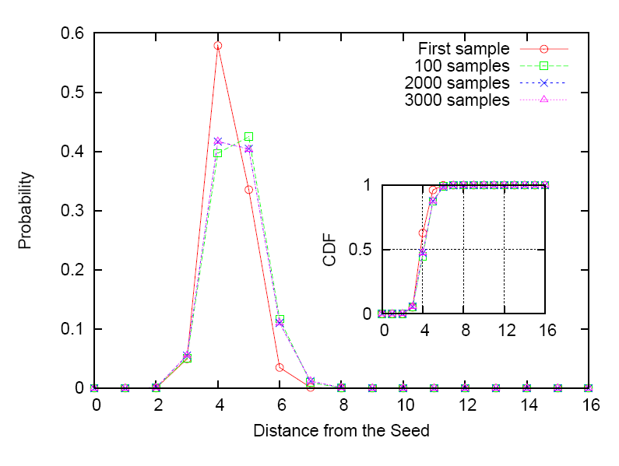
Average Path Length
< 5 is about 90%

Slide 61
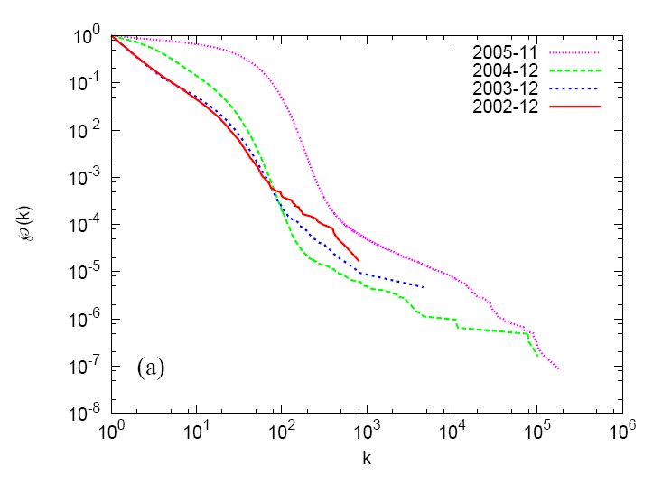
Evolution of Degree Distributions
Two kinds of driving force

Slide 62
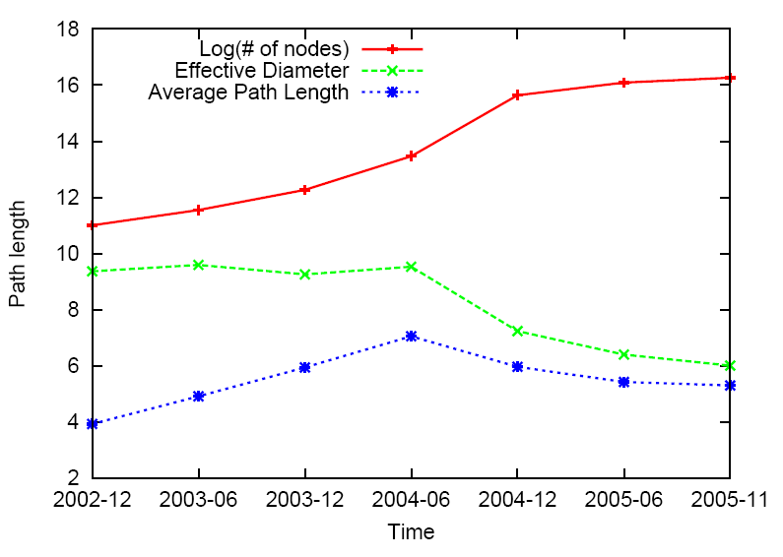
Evolution of Path Length
Start of densification?

Slide 63
How about myspace and orkut?

Slide 64
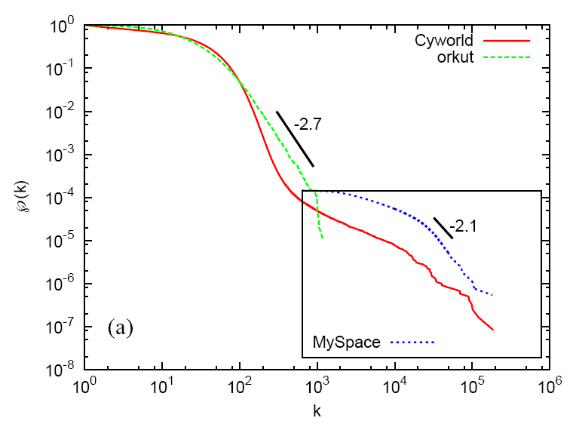
Degree Distributions

Slide 65
What did we learn?

Slide 66
CYWORLD is saturated

Slide 67
but continues to grow

Slide 68
myspace fast growing thru “cyber-only” relationships

Slide 69
POINTs to POnDER

Slide 70
Ease of data collection

Slide 71
Complete data rather than sampled set

Slide 72
Am I asking all the questions?

Slide 73
Or are there many more?

Slide 74
``People search, watch, and keep in touch”
-- Yong-Yeol Ahn

Slide 75
Alexa.com
1 | Yahoo.com
2 | MSN.com
3 | Google.com
4 | YouTube.com
5 | Live.com
6 | MySpace.com
7 | Baidu.com
8 | Orkut.com
9 | Wikipedia.org
10 | qq.com
2007.6.26.
Notes:
baidu.com – google like
qq.com – naver like

Slide 76
Web N.0:
What sciences will it take?
-- Prabhakar Raghavan

Slide 77
Where do I go from here?

Slide 78
References
[1] Ahn et al., “Analysis of Topological Characteristics of Huge Online Social Networks,” WWW 2007
[2] Cha et al., “I tube, you tube, everybody tubes: analyzing the world’s largest user generated content video system,” ACM SIGCOMM IMC 2007 (best paper award)
[3] Cha et al., “Watching television over nationwide IP multicast” under submission
[4] Kwak et al., “Constructing word relationships from tags” in preparation
[5] Willinger et al., “Scaling phenomena in the Internet: Critically examining criticality,” PNAS, vol 99, suppl. 1

